Slide 1

MODEL-BASED INVERSION
Michael Lee
November 29th, 2022

Slide 2
Inverse Problems
What is an inverse problem?

Slide 3
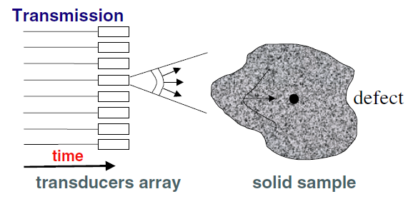
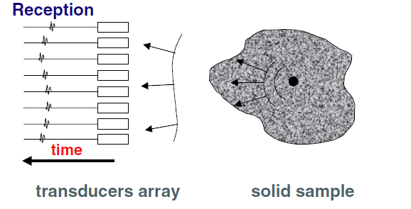
What is an Inverse Problem?
Given a set of observations, find the causes
Example – Inverse scattering
Given
Reflected signals from scatterer(s)
(observations)
Find
The location of the scatterer(s)
(causes)
Applications of Inverse Scattering
— Medical imaging (ultrasound)
— Fault detection
— Ground-penetrating radar
IMAGE SOURCE: Figure 1 from “Time reversal techniques in ultrasonic nondestructive testing of scattering media” by Prada et al

Slide 4
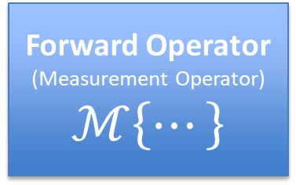
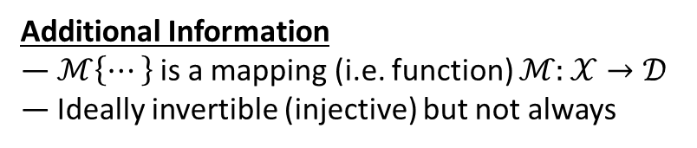
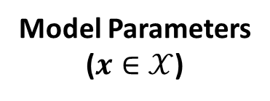

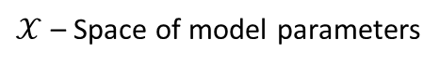

An Abstract View
Forward Operator
(Measurement Operator)
$$ℳ\left\{⋯\right\}$$
Model Parameters
($x∈𝒳$)
Data/Measurements
($d∈\text{𝒟}$)
$𝒳$ – Space of model parameters
$\text{𝒟}$ – Space of data/measurements
Examples of Model Parameters
— Scatterer locations
— Electric field amplitudes/phases
— Depth map of a surface
Examples of Data/Measurements
— Scattered signal waveforms
— Camera sensor measurements
— Phases from interferometry
Maps model parameters to measurements
Additional Information
— $ℳ\left\{⋯\right\}$ is a mapping (i.e. function) $ℳ:𝒳→\text{𝒟}$
— Ideally invertible (injective) but not always
SOURCE: [1] – Introduction to Inverse Problems, by Guillame Bal

Slide 5
The Problem
How to measure heights/depths over a 3D surface?
Notes:
An example of an inverse problem is figuring out the shape of a 3D surface using images taken by a standard camera sensor---like, a charge coupled device or a CMOS image sensor.
[next slide]

Slide 6
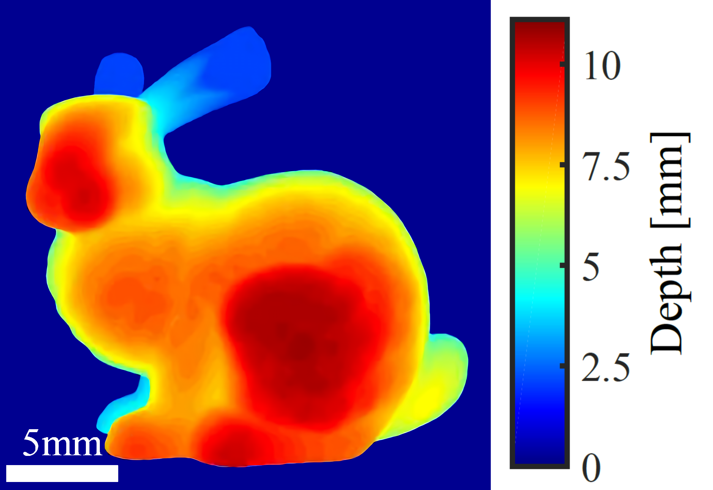
DEPTHMAPS
Depthmaps encode 3D surfaces as depths (or heights)
IMAGE SOURCE: Figure 4 from [2] – “WISHED: Wavefront imaging sensor with high resolution and depth ranging” by Wu et al
Notes:
To give a more visual representation, here is a depthmap.
Depthmaps encode 3D surfaces as depths or heights
So they are kinda like a topographic map of a terrain
Each point on a topographic map has a height
Similarly, one can represent a 3D surface as a series of depths or heights

Slide 7
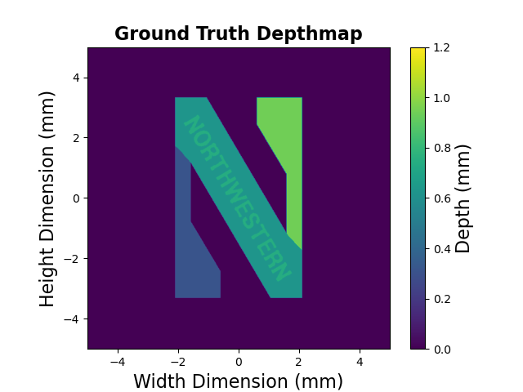

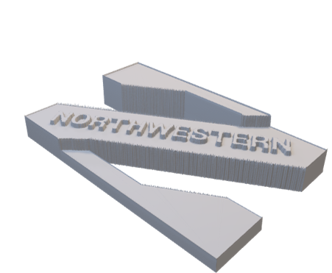
Interpreting Depthmaps
Notes:
So how does one interpret depthmaps?
Well, they are presented as a 2D plot where color represents height
If you look at the upper right segment, the depth is about 1mm and that segment is higher than the rest
This can be seen in the 3D models to the left

Slide 8
The Approach
Using phase to determine distance
Notes:
So how does one obtain a depthmap?
Well, there are a number of methods.
One could use a time-of-flight measurement.
Or maybe a ruler.
Or perhaps some sort of phase measurement, like in optical coherence tomography.
The specific approach taken by the papers I will be presenting on involve using phase to determine distance or depth.

Slide 9
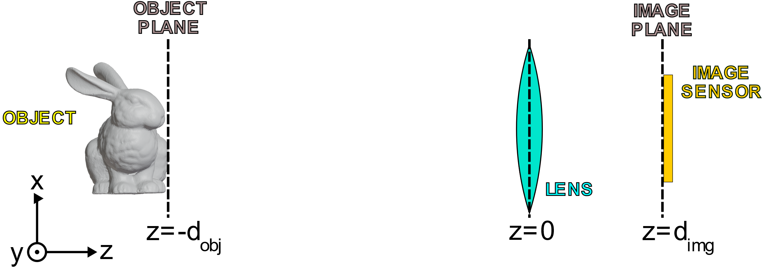
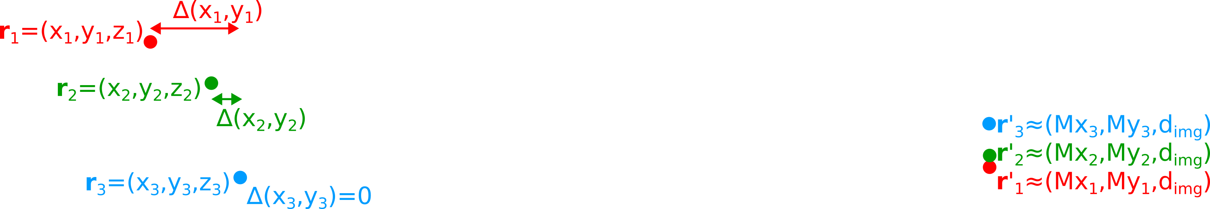
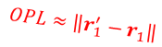
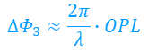

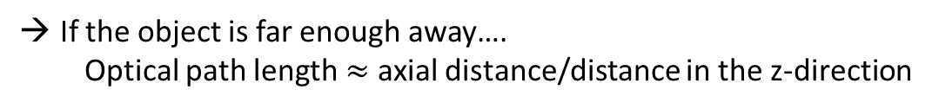
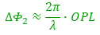
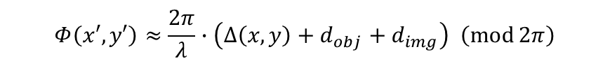
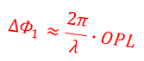
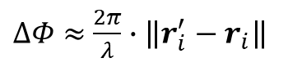

Recovering Depth from Phase
$$OPL≈\left\|r_{1}^{′}−r_{1}\right\|$$
$$∆Φ_{1}≈\frac{2π}{λ}∙OPL$$
$$OPL≈\left\|r_{2}^{′}−r_{2}\right\|$$
$$∆Φ_{2}≈\frac{2π}{λ}∙OPL$$
$$OPL≈\left\|r_{3}^{′}−r_{3}\right\|$$
$$∆Φ_{3}≈\frac{2π}{λ}∙OPL$$
Ideal thin lens → Same-colored lines have the same optical path length (OPL)
Phase shift between points is PROPORTIONAL to optical path length!
How does this relate to depth?
If the object is far enough away….
Optical path length $≈$ axial distance/distance in the z-direction
Can theoretically get depth from the phases at the sensor plane
HOWEVER small $λ$ complicates matters.
$$Φ\left(x′,y′\right)≈\frac{2π}{λ}∙\left(∆\left(x,y\right)+d_{obj}+d_{img}\right) \left(\operatorname{mod}{2π}\right)$$
$$OPL≈\left\|r_{i}^{′}−r_{i}\right\|$$
$∆Φ≈$ $\frac{2π}{λ}∙\left\|r_{i}^{′}−r_{i}\right\|$
Sufficiently large $d_{obj}$, $d_{img}$ → $OPL≈∆\left(x,y\right)+d_{obj}+d_{img}$
Notes:
First some optics
Does anyone know the definition of optical path length?
…
Good! But in this case, since most of this system is air, OPL is pretty much equal to the distance a light ray travels.
(Of course, lens has thickness; can use thin lens approx. and disregard)
All rays coming from point imaged to same point
OPL same for all paths
OPL essentially distance between point on object and point on image
Phase shift prop. to OPL so everything in-phase
---
Troubles with small wavelengths:
Lateral shifts cause phase shifts so phase does not perfectly correspond to depth, lens imperfections, the fact that image plane slightly shifts with differing depth, etc

Slide 10
Challenge – Shifting Image Plane
What about non-planar objects?
Image plane shifts (slightly)!
Ray optics
Points in the object plane get focused onto the image plane
But there are even bigger problems than that…

Slide 11



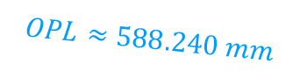
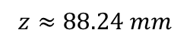
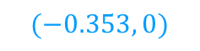
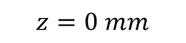
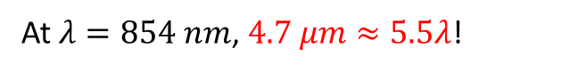

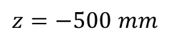


Challenge – Lateral Shifts
$$(2, 0)$$
$$OPL≈588.240 mm$$
Units: mm
$$(0, 0)$$
$$(0, 0)$$
$$OPL≈588.235 mm$$
$$(−0.353, 0)$$
Units: mm
$$OPL≈Depth!$$
$$z=−500 mm$$
$$z=0 mm$$
$$z≈88.24 mm$$
OPL difference $≈4.7 μm$
← Small, right?
Not compared to an optical wavelength!
At $λ=854 nm$, $4.7 μm≈5.5λ$!
Phase difference between paths $≈5.5∙2π≈34.6 radians$!

Slide 12
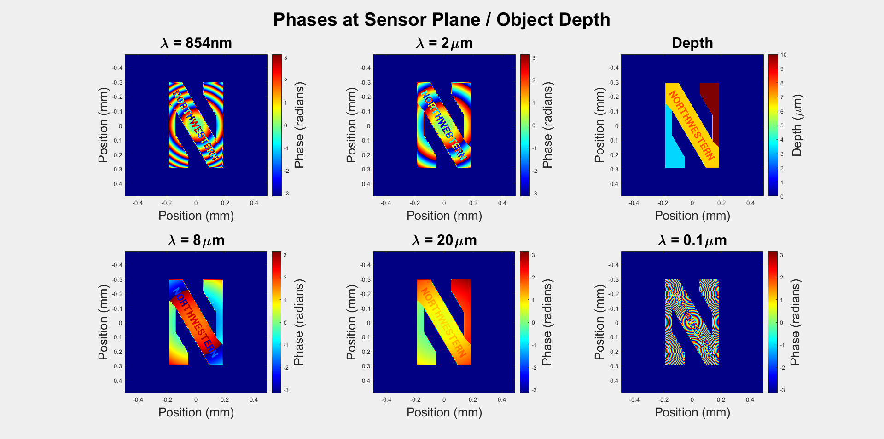
Challenge – Lateral Shifts
Notes:
Here is a visual
Rings due to lateral shifts

Slide 13
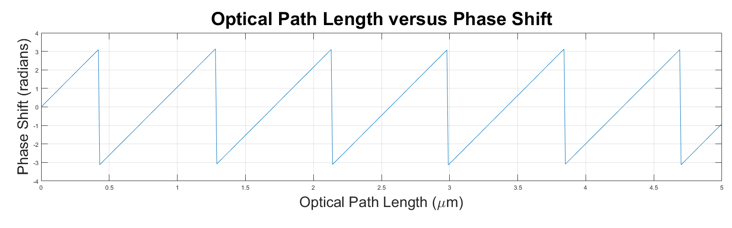
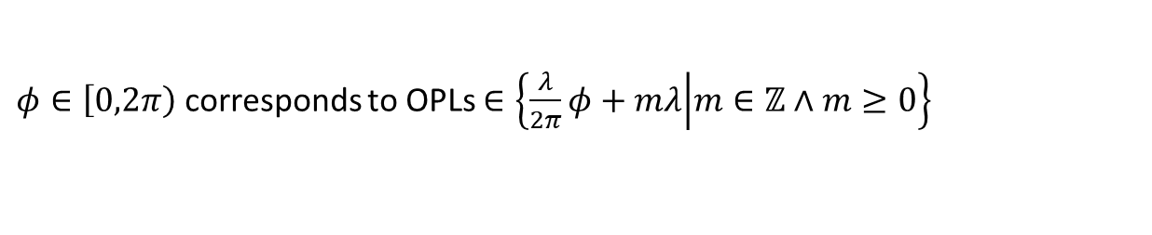
Challenge – Phase Wrapping
Phase shift periodic with period $λ$
A given phase $φ$ corresponds to multiple OPLs, making OPL/distance ambiguous
Example: Cannot tell the difference between distances $0.1λ$ and $0.1λ+5λ$
$λ$ usually small → depth range severely limited (without unwrapping, etc)
$φ∈\left[\left.0,2π\right)\right.$ corresponds to OPLs $∈\left\{\frac{λ}{2π}φ+mλ | m∈ℤ∧m≥0\right\}$

Slide 14

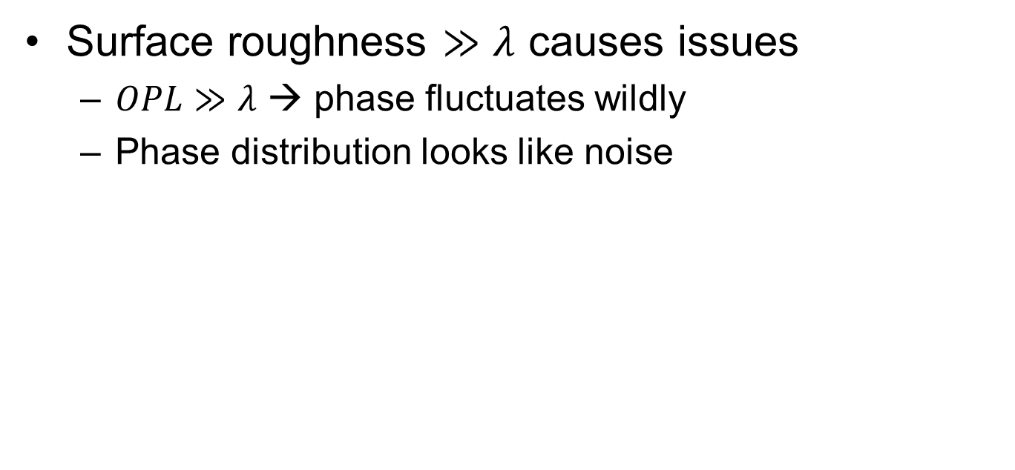
Challenge – Surface Roughness
Surface roughness $≫λ$ causes issues
$OPL≫λ$ → phase fluctuates wildly
Phase distribution looks like noise
$$≫λ$$

Slide 15
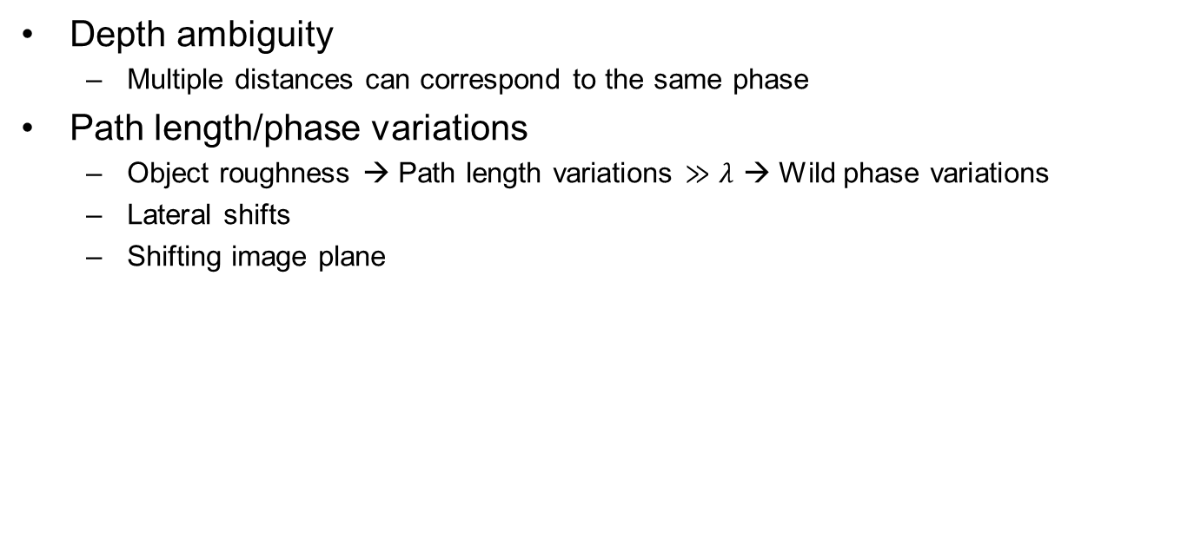
Challenges – Summary
Depth ambiguity
Multiple distances can correspond to the same phase
Path length/phase variations
Object roughness → Path length variations $≫λ$ → Wild phase variations
Lateral shifts
Shifting image plane

Slide 16
Fields and Phases
Notes:
So, now that I have hopefully killed your dreams of using phase to recover depth, let’s learn about fields and phases!
(Deadpan) In all seriousness, the aforementioned problems are addressed later.
Anyways, let’s start with some visuals.

Slide 17
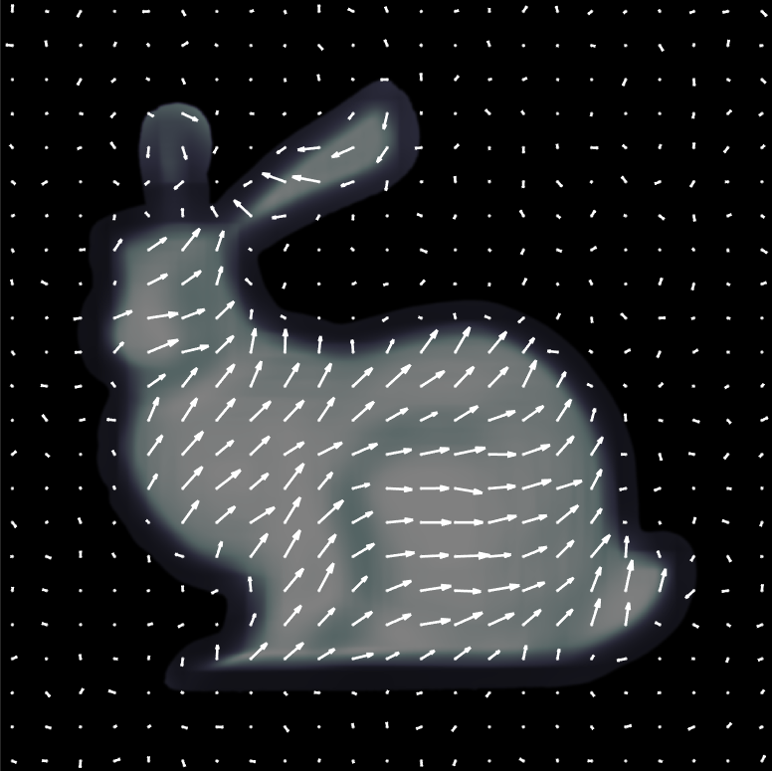
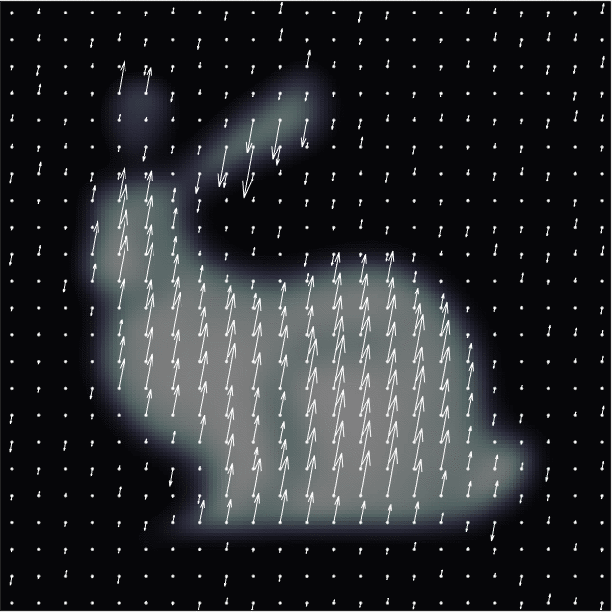
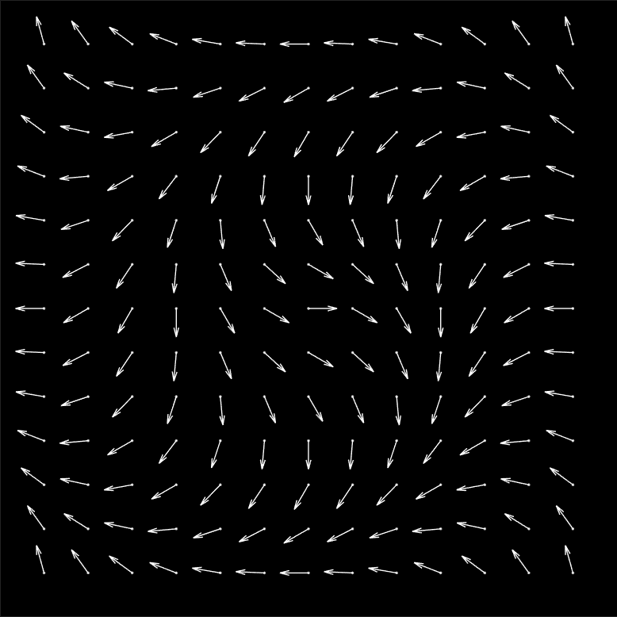
Electric Fields and Phase
Light = Electromagnetic wave
(at least below ultraviolet)
Monochromatic light → Electric field oscillates at a fixed frequency
Fields oscillate in a periodic
pattern/shape
← Phasor representation
Notes:
In optics, we measure light
Light is an electromagnetic wave, at least up to the visible range
Once we start getting up into the ultraviolet range, light starts behaving more like a particle
But we are focusing on visible wavelengths and longer
[advance in slide]
Now, since light is an electromagnetic wave, it has a corresponding electric field
For monochromatic light---i.e. single wavelength or single frequency light---the electric field will oscillate in a periodic fashion.
For example, the field could oscillate linearly, like the linearly polarized field on the left.
[advance in slide]
Or one could have circular polarization, like the field on the right.
Regardless, for monochromatic light, the field at each point oscillates in a pattern.
The patterns are not necessarily uniform across all points, but they all have the same period in time.
Some points might “lag” behind others---in other words, there are phase offsets.
The electric field amplitude can vary from point to point as well.
[brief pause]
So, each point in the electric field has an amplitude and a phase offset associated with it.
Mathematically, the fact that every point oscillates at the same frequency allows us to separate this amplitude and phase from the oscillating-in-time part of the field.
The amplitudes and phases of oscillating waves can be expressed as phasors: complex numbers that have a magnitude and a phase.
In this presentation, we will primarily be working in the phasor domain.
[advance in slide]
[brief pause]
It should be noted though that electric fields are vector fields, so there is a phasor for each component---x, y, and z.
However, for the purposes of this presentation, we can ignore that.
[next slide]
-----------------------
(Ex(x,y,z; t=t0) a_x, Ey(x,y,z; t=t0) a_y, Ez(x,y,z; t=t0) a_z) e^{-jwt} ← can have e^{+jwt} depending on convention

Slide 18
Measuring Phase

Slide 19
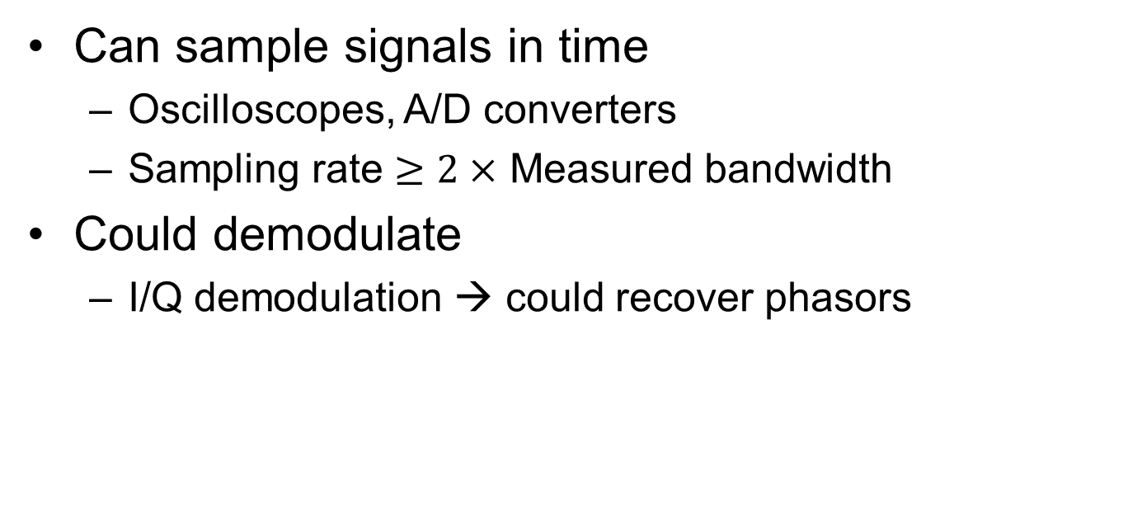
If this were RF/Microwaves…
Can sample signals in time
Oscilloscopes, A/D converters
Sampling rate $≥2×$ Measured bandwidth
Could demodulate
I/Q demodulation → could recover phasors

Slide 20
In optics-land…
Direct sampling
Frequencies in 100’s of THz
No current devices can sample fast enough
Demodulation?
Would need a suitable optical demixer/demodulator
Interferometry?
Yes, but…
Notes:
Sampling
Massive bandwidth needed
Not sure how developed optical mixing technology is
Would almost certainly be less developed than RF/microwave mixers
Instead of demod, perhaps interferometry could be used

Slide 21
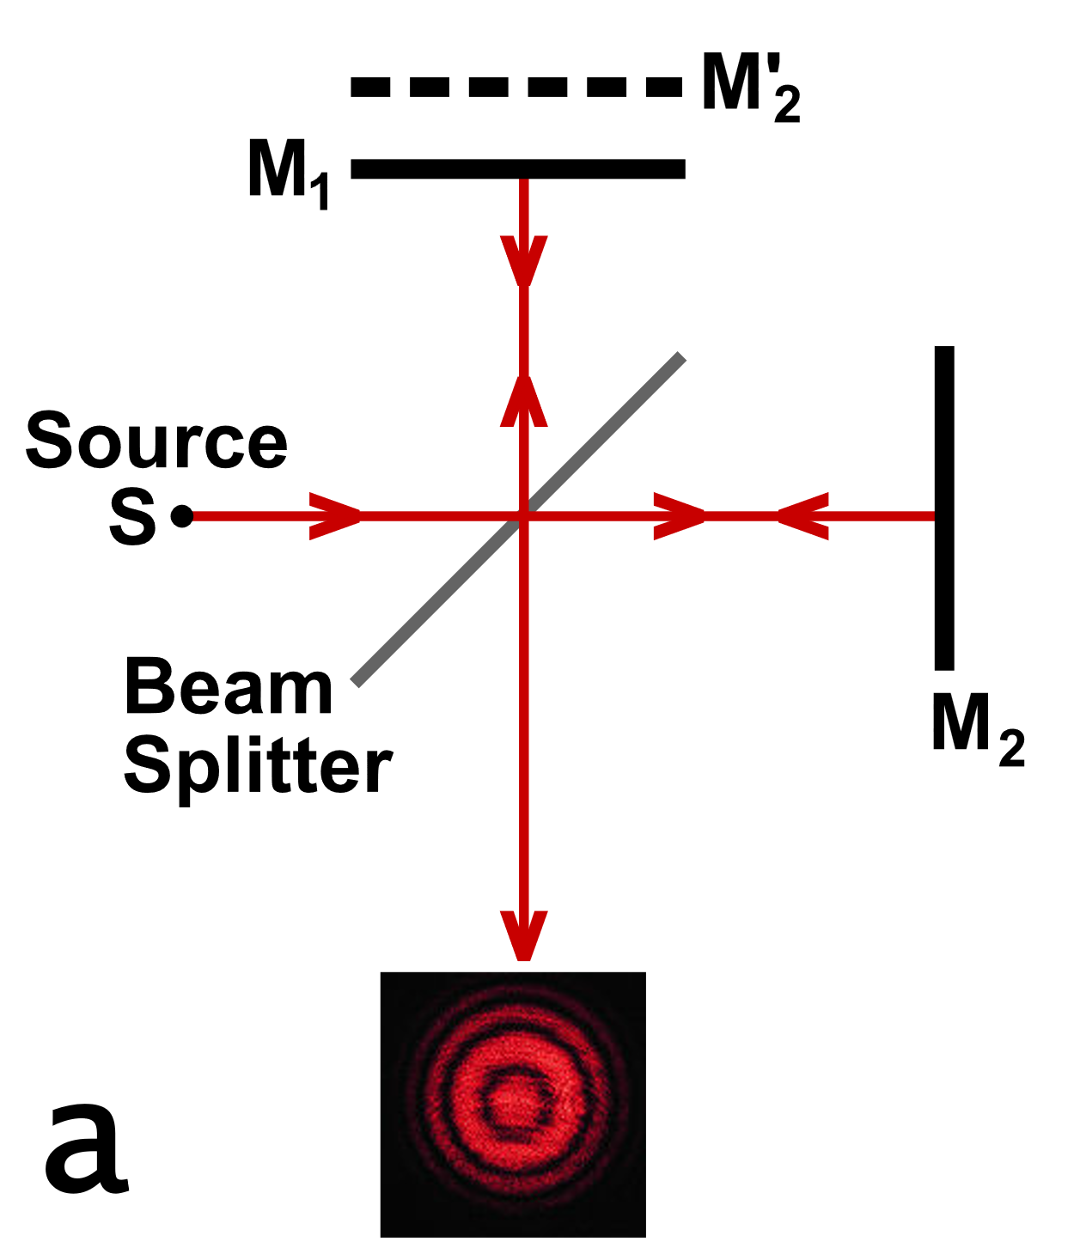
Interferometry
Phase recovered by observing interference patterns
Powerful technique, but…
Small wavelengths → Small disturbances can interfere with measurements
Mismatched sample & reference beam power
→ Contrast in interference pattern reduces
IMAGE SOURCE: https://commons.wikimedia.org/wiki/File:Michelson_interferometer_fringe_formation.svg

Slide 22
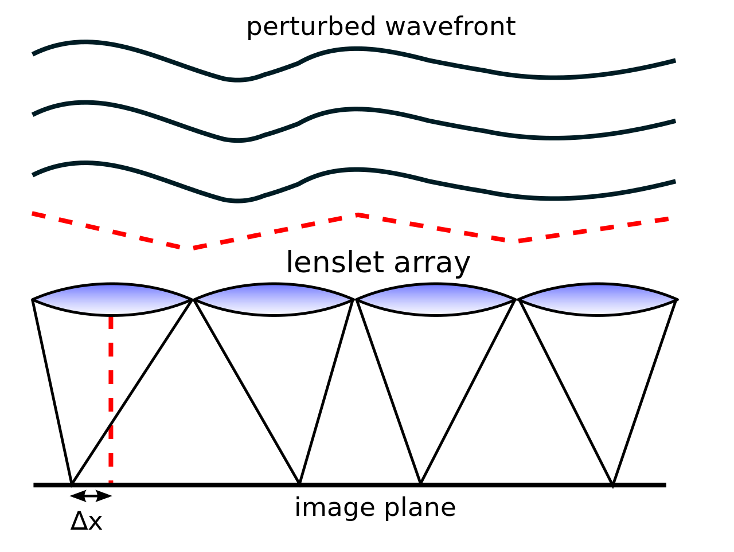
Shack-Hartmann Wavefront Sensor
IMAGE SOURCE: https://commons.wikimedia.org/wiki/File:Shack_Hartmann_WFS_lensletarray.svg
Notes:
Another way is SHWS
Lenslet array placed one focal length away from image sensor
Thus FT relationship
Wavefront phase gradient gets FT’d to a point
Limited resolution due to lenslets
Interference between lenses

Slide 23
Phase recovery/Retrieval
Leveraging computational optics to recover phase
Notes:
So existing methods have some limitations
We live in computer age though
Why not use computers
Can use comp optics to get good phase recovery results

Slide 24
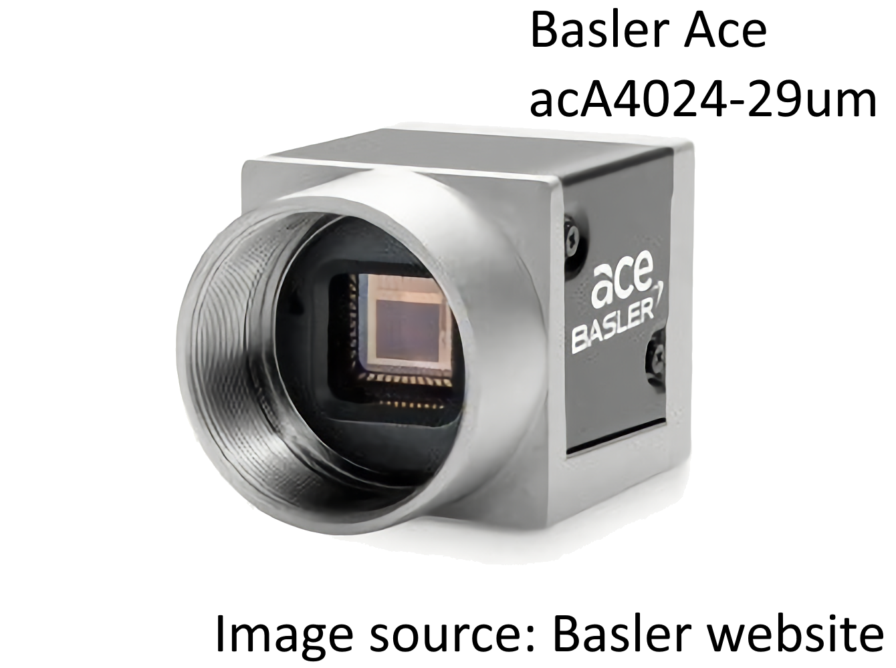

Phase Retrieval Problem
Electric field at sensor plane
Imagine (monochromatic) light shining on
a camera sensor
Standard camera sensors can only measure intensity
Electric field at each point in space has
a magnitude and a phase
Field has a magnitude and a phase at each point
Monochromatic light wavefront
Problem
How does one recover amplitude and phase?

Slide 25


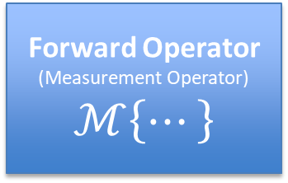

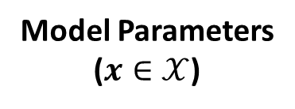
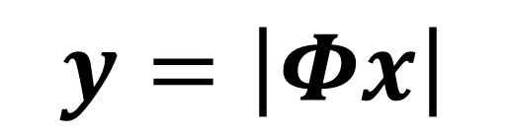
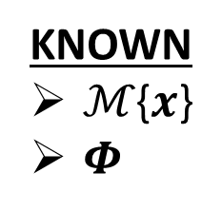
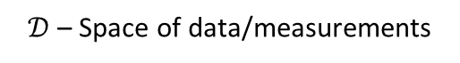
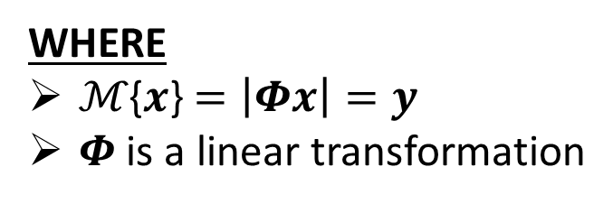
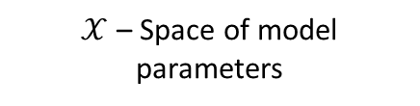
Phase Retrieval Problem – Formal Statement
Forward Operator
(Measurement Operator)
$$ℳ\left\{⋯\right\}$$
Model Parameters
($x∈𝒳$)
Data/Measurements
($y∈\text{𝒟}$)
$𝒳$ – Space of model parameters
$\text{𝒟}$ – Space of data/measurements
Operator describing
propagation + absolute value
Plane you wish to
recover fields for
Plane where you measured intensity
$$Φ\left\{⋯\right\}$$
GIVEN: A measurement 𝒚
FIND: Corresponding parameters $x$
WHERE
ℳ{$x$} $=\left|Φx\right|=\text{y}$
$Φ$ is a linear transformation
KNOWN
ℳ{$x$}
$Φ$
$$\text{y}=\left|Φx\right|$$
SOURCE: [5]
Notes:
But b4 we move on, let’s formalize the phase retrieval problem

Slide 26
Phase Retrieval Methods
Convex relaxations
Approximate message passing
Alternating projection methods
Gerchberg-Saxton
The run-a-model-in-PyTorch-with-autograd-and-do-gradient-descent method
SOURCE: [5]

Slide 27
Gerchberg-Saxton Algorithm
Source Plane
Propagate
Target Plane
Constrain Amplitude
Constrain Amplitude
Invert Propagation
KNOWN
Intensity measurement at source plane
Intensity measurement at target plane
Propagation & inverse propagation operators
SOURCES: [2], [6]
Notes:
There are a number of variations on the Gerchberg-Saxton algorithm.
Does not exactly follow the formal definition for phase retrieval that was described earlier.
Oftentimes have a Fourier transform lens setup so propagation can be modeled by FTs

Slide 28
WISH: Wavefront Imaging Sensor with High Resolution
Obtaining wavefront phases using computational phase retrieval
For more information on WISH, see [3].
Notes:
So how can we use comp. phase retr. in actual system?
Well paper w/in past decade described just that

Slide 29
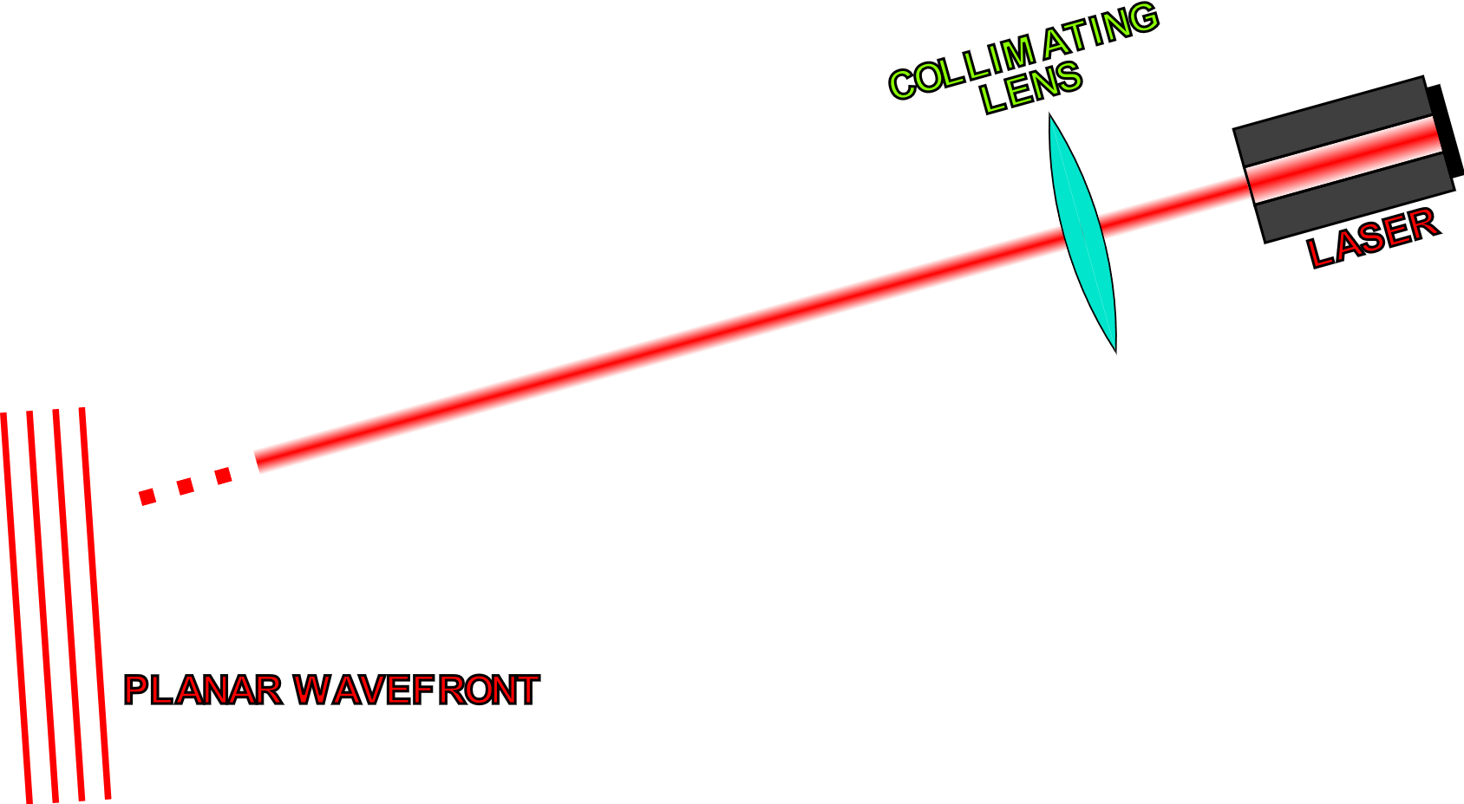
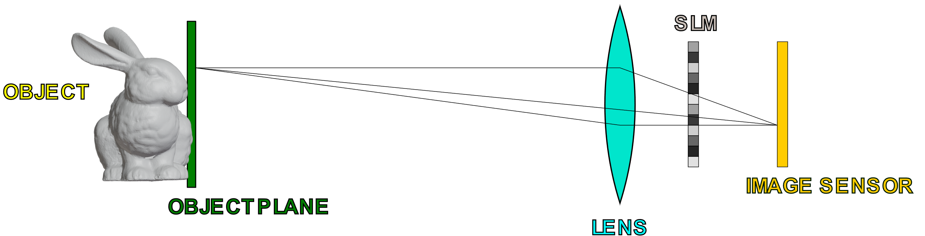
WISH(ED) Setup and General Objective
OBJECTIVE
Recover the complex field (amplitude and phase) on the image sensor plane (without the SLM)
Use the recovered phase to obtain the depthmap of the object.
NOTE: Phase-only SLM
SOURCES: [2], [3]
Notes:
DESCRIBE SLM

Slide 30
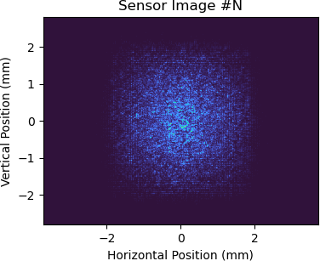
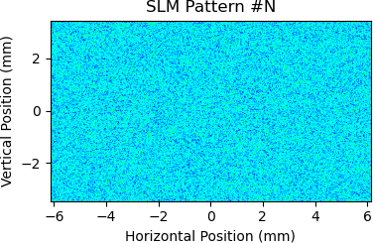
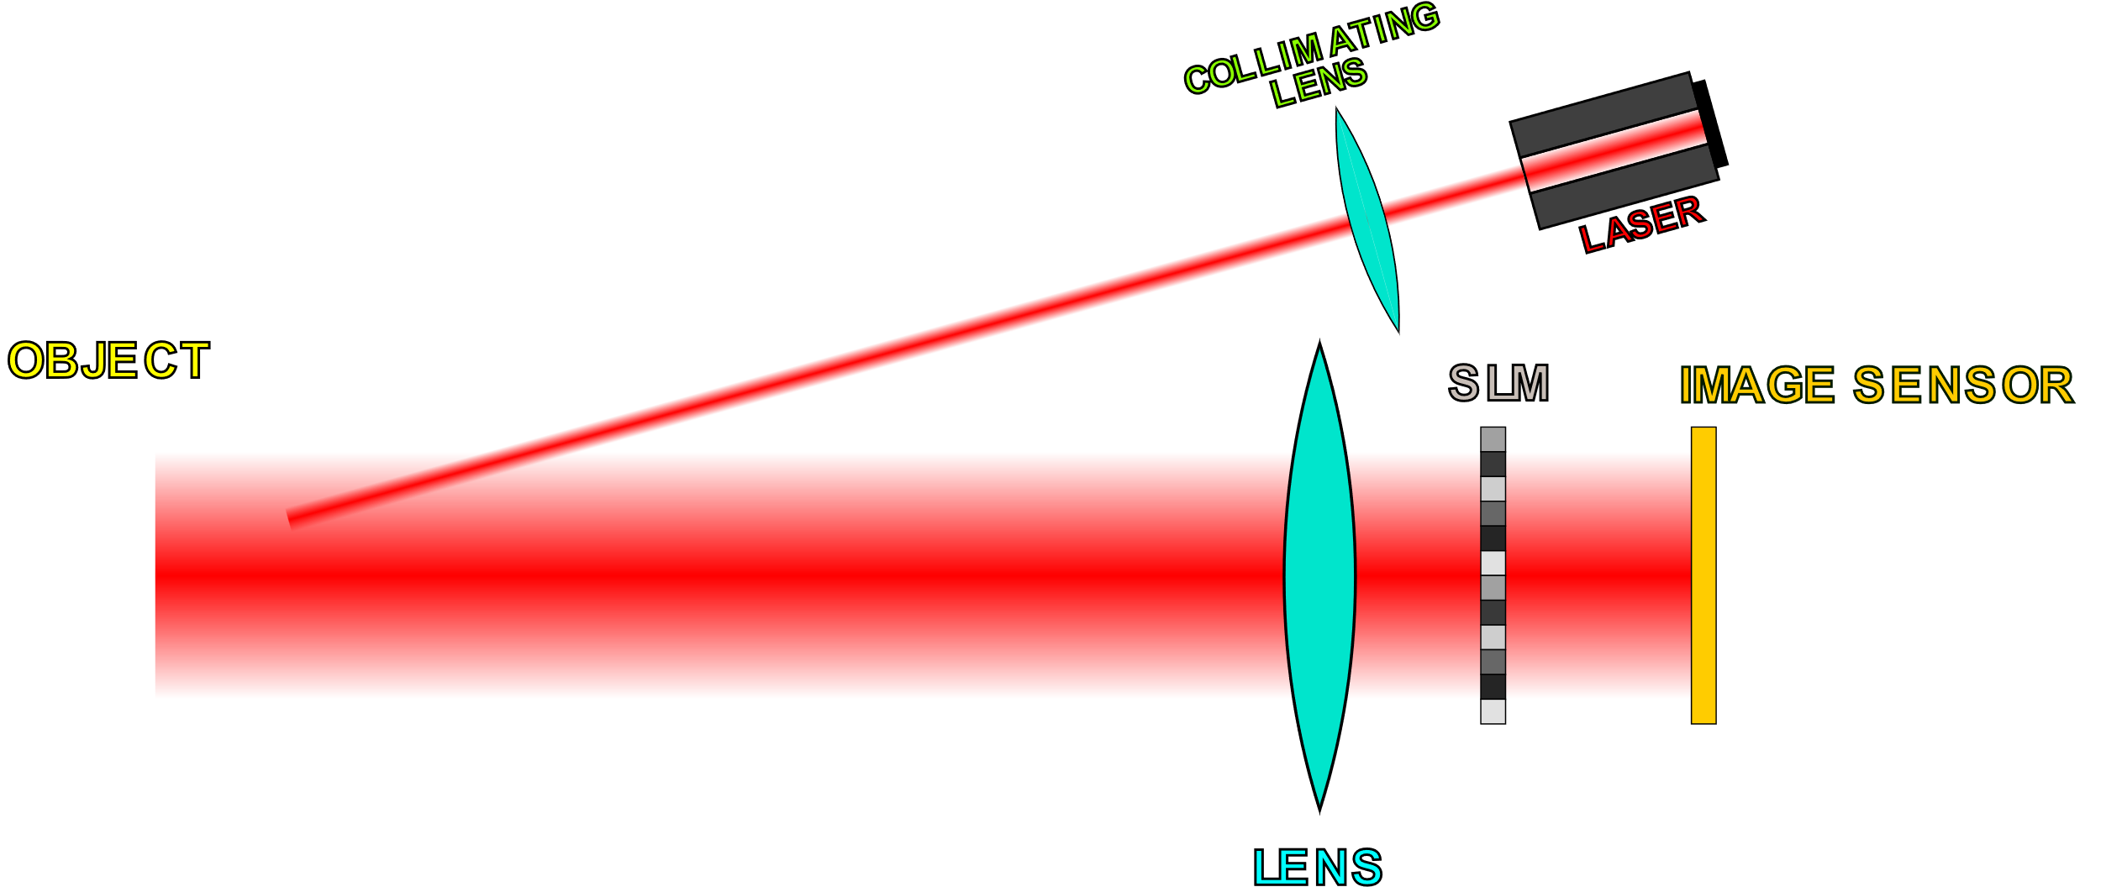
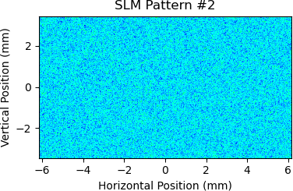
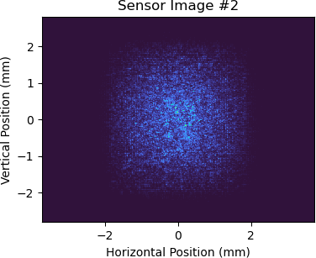



Obtaining Data
Save SLM and sensor data
Recorded Data
Acquire image from sensor
…
Display random phase pattern on SLM
SOURCE: [2]
Can use this data in conjunction with a model for SLM-to-sensor propagation to recover the complex field at the image sensor

Slide 31



Recovering Complex Fields
Objective
Recover field (phase + amplitude) at
the image sensor
Phase Retrieval
Algorithm
Sensor Plane
Complex Fields
Can do phase retrieval
to accomplish this
]
…
SLM Patterns
and
Sensor Data
This data is known/measured
Can focus on SLM and sensor
while disregarding the rest
SOURCE: [2]

Slide 32


Forward Model
$$u_{SLM}$$ | Complex field incident on SLM
$$Φ_{SLM}$$ | Pointwise phase shift applied by SLM
$$\operatorname{ASM}\left(⋯\right)$$ | ASM propagation operator
NOTE: There are other ways of modeling propagation besides ASM (angular spectrum method).

Slide 33







Recovering Sensor Plane Field
SUMMARY
To recover sensor fields:
1. Recover SLM input field
2. Numerically propagate the SLM input field to get the sensor field
Can assume $u_{SLM}$ is the input to the SLM
Can numerically propagate $u_{SLM}$ to obtain $u_{sensor}$
$$u_{SLM}$$
$$u_{sensor}$$
$$u_{SLM}$$
Hypothetical field w/o SLM
SOURCE: [2]

Slide 34







Estimating SLM Input with Optimization
?
Unknown
SLM Plane Field: $u_{SLM}$
$$u_{SLM}$$
Want to find a field ${\hat{u}}_{SLM}$ that gives approximately the same sensor images
$${\hat{u}}_{SLM}$$
Can use optimization accomplish this
Known/Measured
Sensor Images: $\left\{I^{(1)},I^{(2)},⋯,I^{(N)}\right\}$
SLM Patterns: $\left\{Φ_{SLM}^{(1)},Φ_{SLM}^{(2)},⋯,Φ_{SLM}^{(N)}\right\}$
SOURCE: [2]

Slide 35


Optimization Objective Function
$${\hat{u}}_{SLM}=\underset{u_{SLM}}{arg min}{\sum_{i=1}^{N}{{\left\| \sqrt{I^{(i)}} −\left|\operatorname{ASM}\left(Φ_{SLM}^{\left(i\right)}u_{SLM}\right)\right| \right\|}^{2}}}$$
CORE IDEA |
Minimize error between measured intensity patterns and intensity patterns output by model
$${\hat{u}}_{SLM}$$ | Estimated complex field incident on SLM
$$u_{SLM}$$ | Complex field incident on SLM
$$Φ_{SLM}^{(i)}$$ | Pointwise phase shift applied by i^{th} SLM pattern
$$I^{(i)}$$ | Intensity pattern on sensor due to i^{th} SLM pattern
$$\operatorname{ASM}\left(⋯\right)$$ | ASM propagation operator
SOURCE: [2]
NOTE: Other propagation operators besides ASM can also be used.
Notes:
Methods for phase recovery:
Gerchberg-Saxton
Minimizing objective function
System model + PyTorch autograd

Slide 36


Phase Recovery Results (Single Wavelength)
Small $λ$ → Wrapped phases
Wrapped phases are bad for depth recovery
IMAGE SOURCE: Figure 5 from [2] – “WISHED: Wavefront imaging sensor with high resolution and depth ranging” by Wu et al
Notes:
WISH was designed for pretty small scales
Aforementioned lateral phase shifting problem present here
Transmissive analogous to depth

Slide 37
Synthetic Wavelengths
Multiplying fields at two different wavelengths to get a longer, synthetic wavelength
Notes:
Turns out earlier problems can be mitigated with synth wavelengths

Slide 38


First Example – Separate Wavelengths
Wavelength 1
Wavelength 2
Notes:
Here is example
Two separate wavelengths

Slide 39

First Example – Obtaining Synthetic Wavelengths
X
conj
Pointwise multiplication
“conj“ means (pointwise) complex conjugation

Slide 40

First Example – Both Wavelengths
Wavelengths (Superimposed)
Synthetic Wavelength

Slide 41


Second Example – Separate Wavelengths
Wavelength 1
Wavelength 2
Notes:
Now what would this look like on image sensor?

Slide 42

Second Example – Obtaining Synthetic Wavelengths
X
conj
Pointwise multiplication
“conj“ means (pointwise) complex conjugation

Slide 43

Second Example – Both Wavelengths
Wavelengths (Superimposed)
Synthetic Wavelength

Slide 44

Synthetic Wavelengths
Big picture
Can correlate (“multiply”) two complex fields of nearby wavelengths together to get a larger, synthetic wavelength.
Height/depth
Synthetic wavelength
(𝛬)
SOURCE: [2]

Slide 45



Synthetic Wavelength Math
Fields:
$O_{λ_{1}}\left(x,y\right)=A_{λ_{1}}\left(x,y\right)\exp\left[j\frac{2π}{λ_{1}}∙{OPL}_{λ_{1}}\left(x,y\right)\right]$
$O_{λ_{2}}\left(x,y\right)=A_{λ_{2}}\left(x,y\right)\exp\left[j\frac{2π}{λ_{2}}∙{OPL}_{λ_{2}}\left(x,y\right)\right]$
Synthetic fields:
$O_{Λ}\left(x,y\right)=O_{λ_{1}}\left(x,y\right)∙O_{λ_{2}}^{∗}\left(x,y\right)∝\exp\left[j\frac{2π}{Λ}∙d\left(x,y\right)\right]$
$d\left(x,y\right)=\text{∠}O_{Λ}\left(x,y\right)∙\frac{1}{2π}∙\frac{λ_{1}λ_{2}}{\left|λ_{1}−λ_{2}\right|}$
Synthetic wavelength $Λ=\frac{λ_{1}λ_{2}}{\left|λ_{1}−λ_{2}\right|}$
$$λ_{i}$$ | i-th wavelength
$$O_{λ_{i}}\left(x,y\right)$$ | Complex (phasor) field incident on the sensor for $λ_{i}$
$$A_{λ_{i}}\left(x,y\right)$$ | Amplitude of the field incident on the sensor for $λ_{i}$
$${OPL}_{λ_{i}}\left(x,y\right)$$ | Optical path length corresponding to the point $\left(x,y\right)$ for $λ_{i}$
$$d\left(x,y\right)$$ | Distance associated with each point $\left(x,y\right)$. NOTE: ${OPL}_{λ_{i}}\left(x,y\right)≈d\left(x,y\right)$
Notes:
Here is some math

Slide 46
WISHED: Wavefront Imaging Sensor with High Resolution AND DEPTH RANGING
Improving unambiguous depth range using synthetic wavelengths
For more information on WISHED, see [2].
Notes:
WISHED makes use of synth wavelengths

Slide 47

How WISHED Uses Synthetic Wavelengths
Better unambiguous range
$Λ≫λ_{1},λ_{2}$ → wrapped phase for $Λ$ spans larger length
Can combine with an even larger synthetic wavelength to help further unwrap
Less susceptible to path length variations
Less affected by surface roughness
SOURCE: [2]

Slide 48


IMAGE SOURCES: Figures 5 and 12 from [2] – “WISHED: Wavefront imaging sensor with high resolution and depth ranging” by Wu et al

Slide 49
Demo with Synthetic Data*
Done with Python/PyTorch with the Holotorch library [4]
*Of questionable quality/validity.
Notes:
I will be uploading my code and slides later
The reason why I say questionable is because I modeled depth as just a phase shift proportional to displacement along z-direction
Okay approximation---if rays are VERY paraxial

Slide 50
Visualizing the Test Object
NOTE: This is synthetic data, shown for illustrative purposes.

Slide 51





Recovered Sensor Plane Fields
$$u_{sensor}^{\left(λ_{1}\right)}$$
$$u_{synthetic}^{\left(Λ\right)}$$
$$u_{synthetic}^{\left(Λ\right)}=u_{sensor}^{\left(λ_{1}\right)}∙{\left(u_{sensor}^{\left(λ_{2}\right)}\right)}^{∗}$$
Many discontinuities
Infeasible to unwrap phase
No difficult discontinuities
Phase related to depth
$$u_{sensor}^{\left(λ_{2}\right)}$$
NOTE: This is synthetic data, shown for illustrative purposes.

Slide 52

Recovered Depthmaps from Synthetic Data
Median filter
(To remove spikes)
Gaussian filter
(See 2020 WISHED paper)
NOTE: This is synthetic data, shown for illustrative purposes.

Slide 53

Recovered Depthmaps (3D Visualization)
NOTE: This is synthetic data, shown for illustrative purposes.

Slide 54
References
[1] G. Bal, Introduction to Inverse Problems. 2019.
https://www.stat.uchicago.edu/~guillaumebal/PAPERS/IntroductionInverseProblems.pdf.
[2] Y. Wu, F. Li, F. Willomitzer, A. Veeraraghavan, and O. Cossairt, “WISHED: Wavefront imaging
sensor with high resolution and depth ranging,” 2020 IEEE International Conference on
Computational Photography (ICCP), 2020.
[3] Y. Wu, M. K. Sharma, and A. Veeraraghavan, “WISH: Wavefront imaging sensor with high
resolution,” Light: Science & Applications, vol. 8, no. 1, 2019.
[4] Facebookresearch, “Facebookresearch/holotorch: Holotorch is an optimization framework for
differentiable wave-propagation written in PyTorch,” GitHub. [Online]. Available: https://github.com/facebookresearch/holotorch. [Accessed: 21-Nov-2022].
[5] C. A. Metzler, M. K. Sharma, S. Nagesh, R. G. Baraniuk, O. Cossairt, and A. Veeraraghavan, “Coherent inverse scattering via transmission matrices: Efficient Phase Retrieval Algorithms and a public dataset,” 2017 IEEE International Conference on Computational Photography (ICCP), 2017.
[6] “Gerchberg–Saxton algorithm,” Wikipedia, 12-Jul-2022. [Online]. Available:
https://en.wikipedia.org/wiki/Gerchberg%E2%80%93Saxton_algorithm.

